Slide 1

Annual General Meeting
~
Wednesday 6th July 2022
@ Longlevens RFC

Slide 2


Slide 3
National Finalists from Gloucestershire
Chris Harding & Nick Anthony ~ Bristol Saracens RFC
Gary Coles & Sean O’Reilly ~ St Mary’s Old Boys RFC

Slide 4
We remember our friends and colleagues
within rugby who are sadly no longer with us
May they rest in peace

Slide 5
Jonathan Chambers - Fairford RFC / Stroud Combination
JV Smith - GRFU, England Rugby
Eric Blackman - GRFU, Bristol Schools'
Ray Shaw - Ashley Down Old Boys RFC
Gerry Foley - Bristol Referees Society
Brian Newport - Kingswood RFC, Bristol Referees Society
Stuart Slatter - Old Centralians RFC, North Gloucestershire Combination
Reg Muldoon – North Bristol RFC
Maddy Lawrence - UWE Women's Rugby
Sam Polledri - Clifton, Dings Crusaders, St Mary's Old Boys RFC
Neil Maddocks - Clifton RFC
Andy Bywater - Kingswood RFC

Slide 6
Financial Statement
~
Simon Thornton

Slide 7
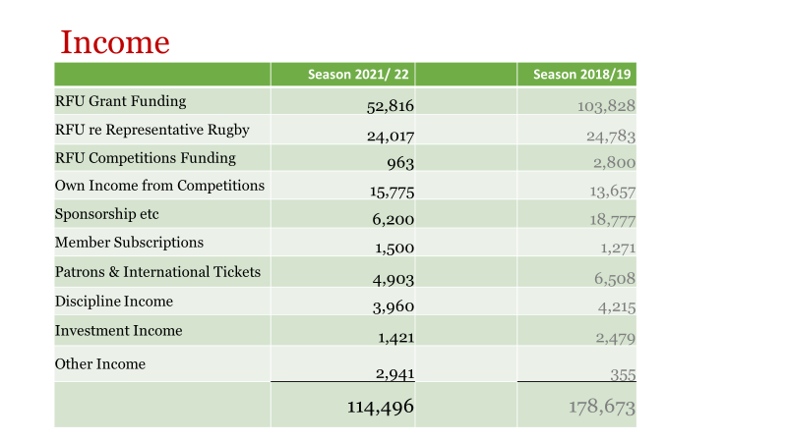

Slide 8
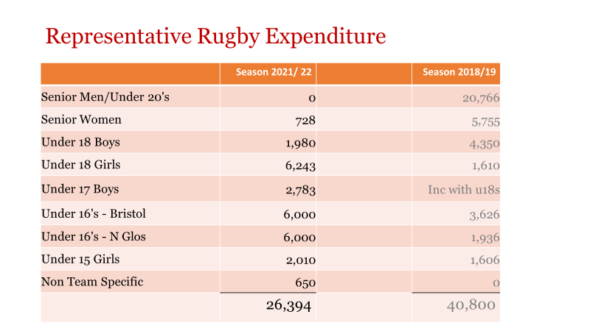

Slide 9
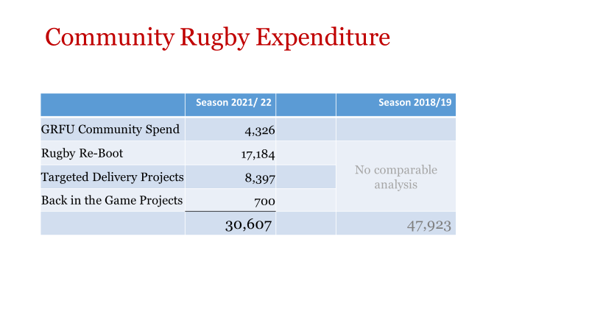

Slide 10
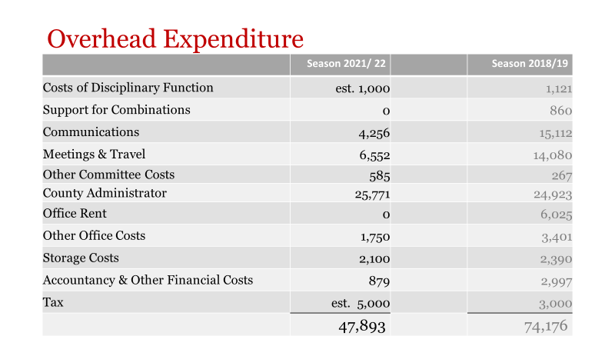

Slide 11
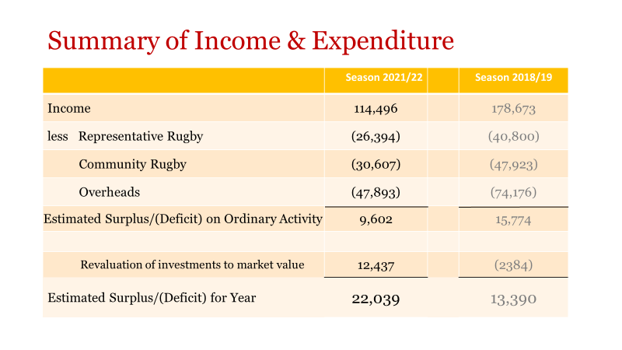

Slide 12
GRFU Overview 2021/22
~
Simon Collyer-Bristow

Slide 13
HIGHS:
:
RETURN TO RUGBY & ON-FIELD ACTIVITIES
AGE-GRADE REPRESENTATIVE
RETURN OF COMBINATION CUPS
7 AGE-GRADE FESTIVALS
GROWTH IN WOMEN & GIRLS’ RUGBY
OFFER OF FIRST AID & REFEREE COURSES

Slide 14
LOWS:
PLAYING NUMBERS & CRY-OFFS
REFEREE SHORTAGES
DECLINE IN CORE VALUES
GROWTH IN MATCH OFFICIAL ABUSE
NO ADULT REPRESENTATIVE RUGBY

Slide 15
GRFU main Objectives 2022/23
CB REVIEW, RE-STRUCTURE & RE-BOOT
COMPETITIONS BED-IN
ADDRESS DISCIPLINE ISSUES
FINANCE, FUNDING & SPONSORSHIP
BUILD-UP VOLUNTEER NUMBERS

Slide 16
Questions ?

Slide 17
CB restructure
~
MARK NICHOLSON

Slide 18
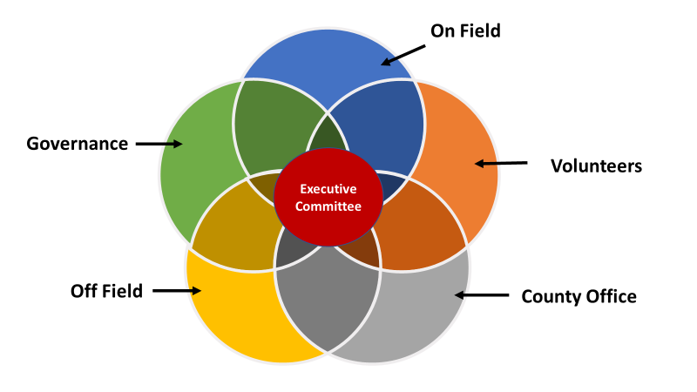
PROPOSED
CB STRUCTURE

Slide 19
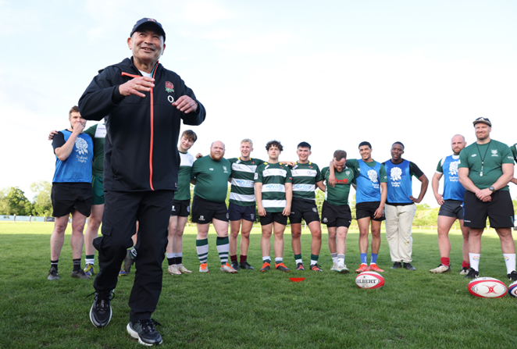
ON-FIELD
Competitions
Festivals
Age Grade, Schools, Colleges & Universities
Senior Men’s
Women
Girls’
Coaching
Representative
Academies, CoE, DPP
Referee Societies

Slide 20

OFF-FIELD
Patrons & Membership
Sponsorship
Purchasing
Facilities
Funding & Grants
International Tickets

Slide 21

VOLUNTEER
DEVELOPMENT
  Succession
  Volunteers
  Awards
  Diversity & Inclusion

Slide 22

GOVERNANCE & WELFARE
Discipline
Safeguarding
Player Welfare
RugbySafe
Governance

Slide 23

COUNTY OFFICE
  #GRFU
  Communications
  Social Media
  Marketing & Branding
  IT & infrastructure

Slide 24

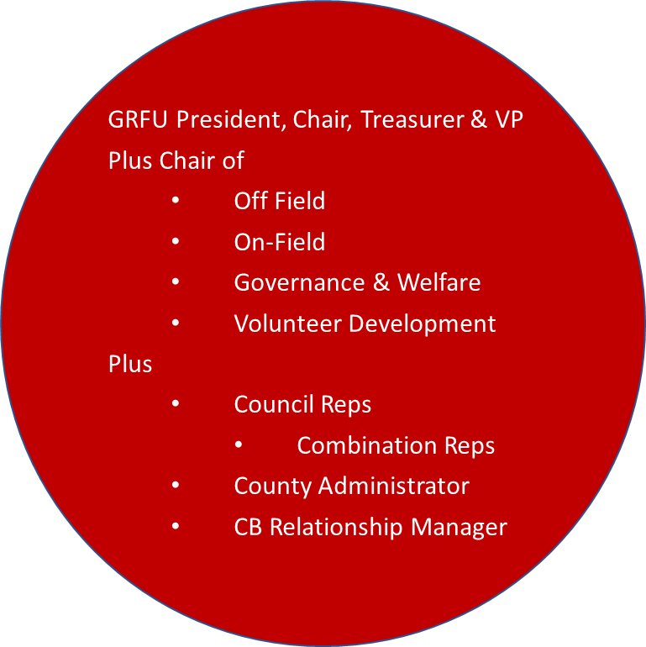
EXECUTIVE COMMITTEE

Slide 25
Questions?

Slide 26
Tribute RFU LEAGUES – 2021/22
Tribute Western Counties North ~ Matson RFC
Tribute Gloucestershire Premier ~ Longlevens RFC
Tribute Gloucestershire One North ~ Smiths RFC
Tribute Gloucestershire One South ~ Dursley RFC
Tribute Gloucestershire Two North ~ Cheltenham Civil Service RFC
Tribute Gloucestershire Two South ~ Old Colstonians RFC

Slide 27
GRFU DISTRICT LEAGUES ~ 2021/22
Bristol and District 1:
Winner ~ Yate
Runner Up ~ Bristol Saracens 2
Bristol and District 2:
Winner ~ Southmead 2
Runner Up ~ North Bristol 2
Gloucester and District 1:
Winner ~ Cinderford 3
Runner Up ~ Longlevens 2
Gloucester and District 2:
Winner ~ Minchinhampton 2
Runner Up ~ Old Cryptians 3

Slide 28
Referee Society ~ 25 years service
  Steve Bowen ~ Gloucester & District Referee Society
  Adrian Stephenson ~ Gloucester & District Referee Society
  Nigel Stephenson ~ Gloucester & District Referee Society

Slide 29
Gloucestershire Awards
  Gino Beaumont ~ Minchinhampton RFC
  Mike Delderfield ~ Ashley Down Old Boys RFC
  Billy Fishwick ~ Gloucester & District Referee Society
  Stan Fritchley ~ Old Cryptians RFC
  Derek Golding ~ Kingswood RFC
  John Wood ~ Cinderford RFC
  Rob Worgan ~ Cinderford RFC

Slide 30
The Roy Phillips Award
    Ian Hillier

Slide 31
President’s Award
    Tony Swash

Slide 32
Gloucestershire Life Member
  David Parry - Jones

Slide 33
THANK YOU ~
to all of you who support the game of rugby within Gloucestershire
to our partners, some of who are with us tonight
to Longlevens RFC for hosting us tonight!

